Slide 1
Genetic Algorithms
Student : Mateja Saković 3015/2011

Slide 2
Introduction
Genetic algorithms are based on evolution and natural selection
Evolution is any change across successive generations in the heritable characteristics of biological populations
Natural selection is the nonrandom process by which biological traits become either more or less common in a population

Slide 3
Introduction(2)
Genetic algorithms apply the same idea to problems where the solution can be expressed as an optimal individual and the goal is to maximize the fitness of individuals
Genetic algorithms find application in bioinformatics, phylogenetics, computational science, engineering, economics, chemistry, manufacturing, mathematics, physics and other fields.

Slide 4
History
1957 – Alex Fraser – simulation of evolution
1960 – Rechenberg's group – solving complex engineering problems with evolutionary programming
1967 - J. D. Bagley - term genetic algorithms
1975 – John Holland – “Adaptation in Natural and Artificial Systems ”
1980 – General electric – first GA product

Slide 5
Algorithm
1. Identify the genome and fitness function
2. Create an initial generation of genomes
3. Modify the initial population by applying the operators of genetic algorithms
4. Repeat Step 3 until the fitness of the population no longer improves
Genome is apopulation of strings which encode candidate solutions
Fitness function is a function that combines the parameters into a single value
Operators — selection, crossover and mutation

Slide 6
Initialization
Individual solutions are randomly generated to form an initial population (usually)
Solutions may be seeded in areas where optimal solutions are likely to be found (occasionally)
Population size depends on the nature of the problem

Slide 7
Operators
Selection keeps the size of the population constant but increases the fitness of the next generation. Genomes with a higher fitness proliferate and genomes with lower die off.
Crossover is a way of combining two genomes
Mutation makes an occasional random change to a random position in a genome

Slide 8
Selection
The chance of a genome surviving to the next generation is proportional to its fitness value
Size of the population remains constant
1.The fitness function is evaluated for each individual, providing fitness values, which are then divided by the sum of all fitness values
2. A random number R between 0 and 1 is chosen
3.The selected individual is the first one whose accumulated normalized value is greater than R
4. Repeat this procedure until there are enough selected individuals

Slide 9
Crossover
Creates two new genomes(children) from two existing ones
The first part of one genome swaps places with the first part of the second (genomes are divided in random position)
1. Select pairs of genomes and flipping a coin to determine whether they split and swap.
2. If they do crossover, then a random position is chosen and the children of the original genomes replace them in the next generation
3. Repeat step 1 for all pairs of parents in population

Slide 10
Mutation
Miscoded genetic material being passed from a parent to a child
Mutation rate is quite small for GA, usually one mutation per generation
When a mutation occurs, the bit changes from a 0 to a 1 or from a 1 to a 0
Helps avoid premature convergence to a local optimum

Slide 11
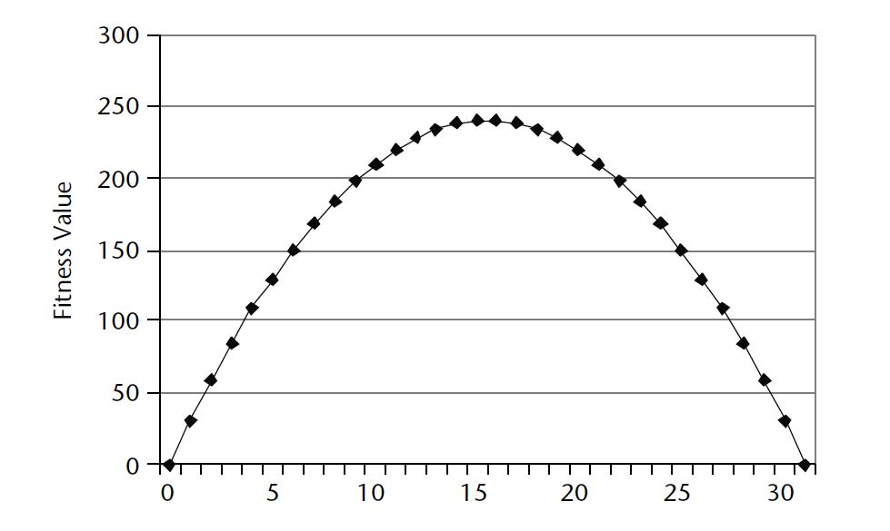
Example
Find maximum value of a function 31p – p² with a single integer parameter p (0<=p<=31)
P is a string of 5 bit

Slide 12
Initialization – example
Four randomly generated genomes
Genome | P | Fitness
10110 | 22 | 198
00011 | 3 | 84
00010 | 2 | 58
11001 | 25 | 150

Slide 13
Selection - example
Genome | Fitness | % of total fitness | copies
10110 | 198 | 40.4% | 1.62
00011 | 84 | 17.1% | 0.69
00010 | 58 | 11.8% | 0.47
11001 | 150 | 13.6% | 1.22
Selection
Genome | P | Fitness
10110 | 22 | 198
11001 | 25 | 150
00010 | 2 | 58
10110 | 22 | 198

Slide 14
Crossover - example
Crossover for 10110 and 00010
10|110
00|010
00110
10010
Genome | P | Fitness
10010 | 18 | 234
11001 | 25 | 150
00110 | 6 | 150
10110 | 22 | 198

Slide 15
Mutation - example
Mutation in 11001 on position 3
11001 -> 11101
Genome | P | Fitness
10010 | 18 | 234
11101 | 29 | 58
00110 | 6 | 150
10110 | 22 | 198

Slide 16
Pros and cons
Advantages :
Understandable
Can solve any problem which can be encoded
Easily distributed
Disadvantages :
Expensive fitness function evaluations
Converge towards local optimum or even arbitrary points rather than the global optimum
GAs cannot effectively solve problems in which the only fitness measure is a single right/wrong measure

Slide 17
Improvements
Crowding – populaton grow in size (fast convergence)
DNA - two possible values for each gene, remembering a gene that was useful in another environment

Slide 18
Refrences
Michael J.A. Berry, Gordon S. Linoff “Data Mining Techniques For Marketing, Sales, and Customer Relationship Management”, 2004
Wikipedia - http://www.wikipedia.org/

Slide 19
Thank you for attention!
Questions?
Mateja Saković 3015/2011

